Slide 1












Web Scraping with R

Slide 2

About Me
Elijah Appiah from Ghana.
Ph.D. Economics at NIDA in Bangkok, Thailand.
Economist by profession.
Data Scientist by passion.
Enthusiastic about working with data daily.
Technical skills in LATEX, Microsoft Office (Word, Excel, PowerPoint), SPSS, Stata, EViews, Python, R, Power BI, Tableau, and Google TensorFlow.
Especially passionate about Statistics and R.

Slide 3
IDE and Packages for this Lecture
Main IDE for R is Rstudio
Packages:
rvest
xml
httr

Slide 4
Outline
Introduction to HTML and Web Scraping
Navigation and Selection with CSS
HTTP Request

Slide 5
What is Web Scraping?
Process of extracting data from websites.
The purpose is to gather data for various purposes such as research, analysis, and integration into applications.

Slide 6
HTML Basics – Elements, Tags, Attributes
HTML – Hypertext Markup Language (structure of a website)
Elements
HTML documents are structured using elements, which define the structure and content of a web page.
p (paragraph), h1 (first-level heading), img (image), b (bold formatting), etc…

Slide 7
HTML Basics – Elements, Tags, Attributes
HTML – Hypertext Markup Language (structure of a website)
Tags
Tags are the elements enclosed in angle brackets, that denote the beginning and end of an HTML element. HTML elements have both opening and closing tags.
<p>This is a simple paragraph.</p>
<h1>Welcome to our Website</h1>

Slide 8
HTML Basics – Elements, Tags, Attributes
HTML – Hypertext Markup Language (structure of a website)
Attributes
Attributes provide additional information about an HTML element, and are placed within the opening tag. They are typically in the form of name-value pairs.
<a href="https://www.example.com">Visit Example.com</a>
<img src="image.jpg" alt="A beautiful landscape">

Slide 9
Anatomy of a Webpage
Document Declaration (document type and version)
<!DOCTYPE html>
Root Element (container for the entire HTML document)
<html> head and body tags enter here </html>
Head (contains metadata and information about the document itself)
<head> … </head>
Body (visible content that users see and interact with when they visit a web page)
<body> … </body>

Slide 10
Anatomy of HTML Document
Document type declaration
<!DOCTYPE html>
<html>
<head>
<title>Sample Page</title>
</head>
<body>
<h1>Welcome to Web Scraping!</h1>
<p>This is a simple HTML example.</p>
<a href="https://www.example.com">Visit Example.com</a>
</body>
</html>
Head
Root
Element
Body

Slide 11
Reading HTML with R
Read HTML into R
install.packages(“rvest”)
library(rvest)
html <- read_html(x)
Check structure of the HTML object
install.packages(“xml2”)
library(xml2)
xml_structure(html)

Slide 12

Now, let’s practice

Slide 13
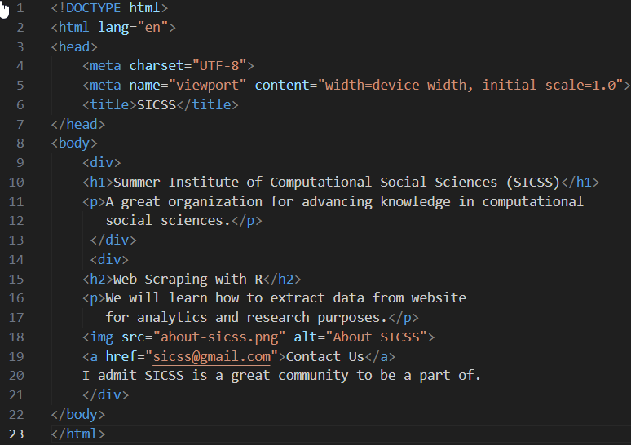
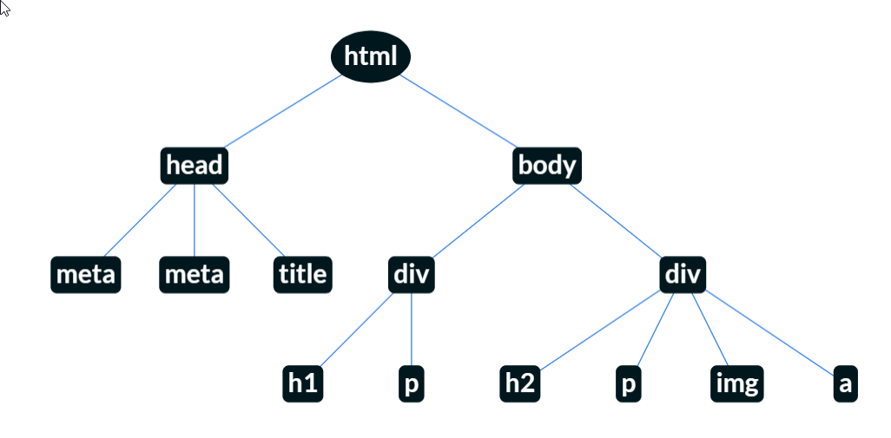
Navigate HTML – Like a Tree

Slide 14
Navigating HTML – Navigating Nodes with Selectors
Navigating Nodes (Parents and Children)
html_node(html, “p”)
html %>% html_node(“p”)
html %>% html_nodes(“p”)
html %>% html_elements(“body”)
html %>% html_elements(“body”)
html %>% html_elements(“div p”)
html %>% html_elements(“div, p”)
html %>% html_element(“p”) %>% html_text()

Slide 15
Navigating HTML – Navigating Attributes
Navigating Attributes
html %>% html_element(“a”) %>% html_attr(“href”)
html_attr() vs. html_attrs()

Slide 16
Now, let’s practice

Slide 17
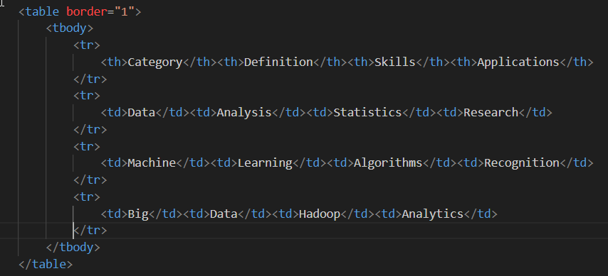
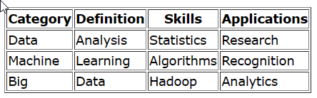
Scraping Tables

Slide 18
Scraping Tables
Read and view tables
table <- read_html(x)
table %>% html_table()
table %>% html_table(header = TRUE)
Scrape a table from Wikipedia
https://en.wikipedia.org/wiki/List_of_Nobel_laureates

Slide 19
Now, let’s practice

Slide 20
CSS
CSS – Cascading Style Sheets (format html documents)
Styling HTML Elements
CSS can be applied to HTML elements using selectors. Selectors target specific elements on a web page, such as headings, paragraphs, links, or classes and IDs that you define.
CSS rules consists of property-value pairs (e.g. color: blue, font-size: 12)
HTML Selectors
Class Selectors
ID Selectors
<h1>Hello</h1>
h1 {
property: value;
}
<h1 class=“hello”>Hello</div>
.hello {
property: value;
}
<div id=“hello”>Hello</div>
#hello {
property: value;
}

Slide 21
CSS – Type Selectors
type {
property: value;
}
html %>% html_elements(“type”)
type1, type2 {
property: value;
}
html %>% html_elements(“type1, type2”)
* {
property: value;
}
html %>% html_elements(“*”)

Slide 22
Now, let’s practice

Slide 23
CSS – Classes and IDs
.class {
property: value;
}
html %>% html_elements(“.class”)
html %>% html_elements(“h1.class”)
.class1 {
property: value;
}
.class2 {
property: value;
}
html %>% html_elements(“.class1.class2”)
#id {
property: value;
}
html %>% html_elements(“#id”)

Slide 24
Now, let’s practice

Slide 25
CSS – Pseudo Classes
<ol>
<li>First Item</li>
<li>Second Item</li>
<li>Third Item</li>
</ol>
1. First Item
2. Second Item
3. Third Item
li:first-child {color: blue;}
li:nth-child(2) {color: red;}
li:last-child {color: green;}
html %>% html_elements(“li:first-child”)

Slide 26
Now, let’s practice

Slide 27
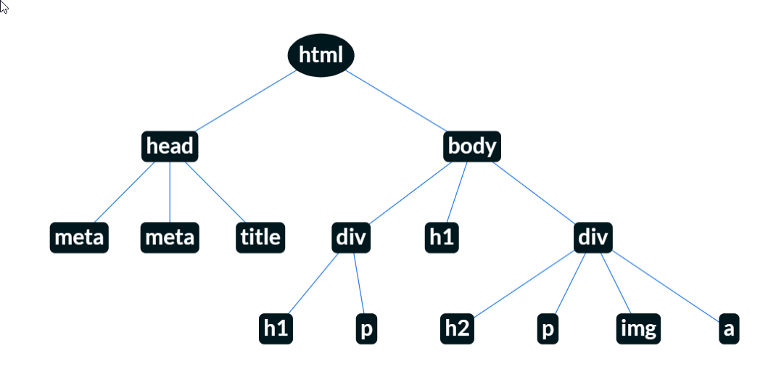
CSS - Combinators
The CSS Combinators are:
Combinator | Meaning
space | Descendant
> | Child
+ | Adjacent sibling
~ | General sibling

Slide 28
Now, let’s practice

Slide 29
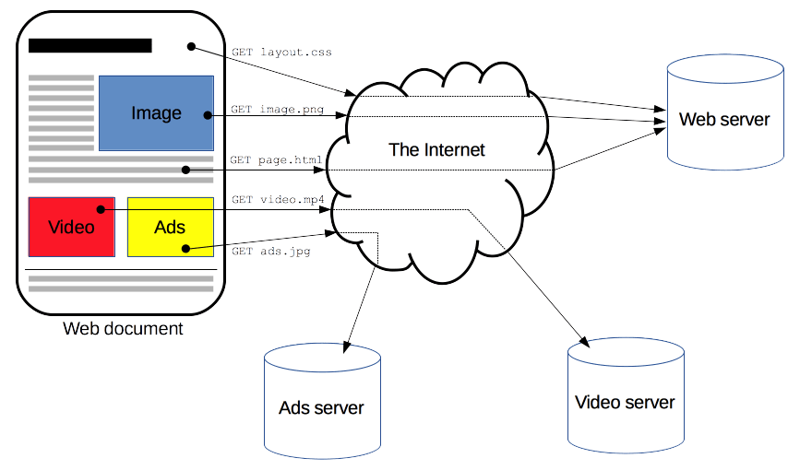
HTTP Requests
HTTP – HyperText Transfer Protocol
Set of rules that dictate how web browsers, or clients, communicate with a web server.
Source: https://developer.mozilla.org/en-US/docs/Web/HTTP/Overview

Slide 30
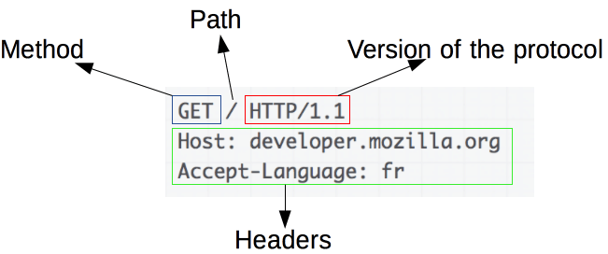
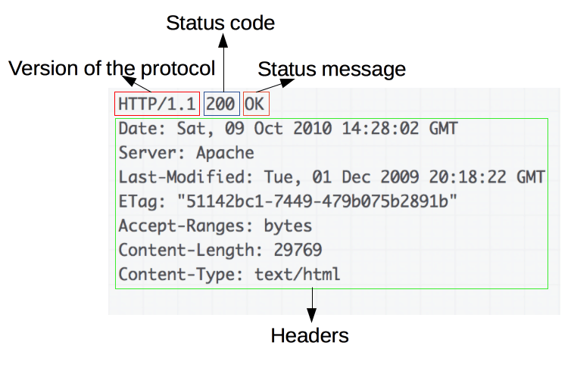
Anatomy of HTTP Requests
Request:
A request is sent to the web server.
Response:
A response is received from the web server.
Common status codes:
200 (OK), 404 (NOT FOUND), 300s (redirect), 500s (server errors).
Source: https://developer.mozilla.org/en-US/docs/Web/HTTP/Overview

Slide 31
Request Methods – GET and POST
GET
Fetch a resource without submitting data (GET /index.html).
POST
Send data to a server (after filling out a form on a page).
Source: https://developer.mozilla.org/en-US/docs/Web/HTTP/Overview

Slide 32
HTTP Request with “httr” Package
install.packages(“httr”)
library(httr)
response <- GET(url = “https://wikipedia.com”)
content(response)
status_code(response)

Slide 33
Now, let’s practice

Slide 34
Why HTTP Request?
Web server already registers your IP address.
Purposes of identification (HTTP Header does that).
Modify Headers
response <- GET(“https://Wikipedia.com”, user_agent(“Hello, it’s me, Eli!”))

Slide 35
Making Slow Requests – purr Package
install.packages(“purrr”)
library(purr)
url_list <- c(“http://example.com/page1”,
“http://example.com/page1”,
“http://example.com/page1”)
slow_request <- slowly(read_html, rate = rate_delay(3))
for(url in url_list){
html <- slow_request(url)
}

Slide 36
Now, let’s practice

Slide 37
THANK
YOU

